Slide 1
Vector Semantics & Embeddings
Word Meaning
Edited from Dan Jurafsky’s book website: https://web.stanford.edu/~jurafsky/slp3/
Notes:
Let's begin with some linguistic background on word meaning

Slide 2
What do words mean?
N-gram or text classification methods we've seen so far
Words are just strings (or indices w_{i} in a vocabulary list)
That's not very satisfactory!
Introductory logic classes:
The meaning of "dog" is DOG; cat is CAT
∀x DOG(x) ⟶ MAMMAL(x)
Old linguistics joke by Barbara Partee in 1967:
Q: What's the meaning of life?
A: LIFE
That seems hardly better!
Notes:
How do we represent the meaning of words in NLP systems? in classical NLP applications, our only representation of a word is as a string of letters, or an index in a vocabulary list.
This representation is not that different from a tradition in philosophy, perhaps you’ve seen it in introductory logic classes, in which the meaning of words is represented by just spelling the word with small capital letters; representing the meaning of “dog” as DOG, and “cat” as CAT.
Representing the meaning of a word by capitalizing it is a pretty unsatisfactory model. You might have seen a joke due originally to semanticist Barbara Partee (Carlson, 1977):
Q: What’s the meaning of life? A: LIFE’
Surely we can do better than this

Slide 3
Desiderata
What should a theory of word meaning do for us?
Let's look at some desiderata
From lexical semantics, the linguistic study of word meaning

Slide 4
Lemmas and senses
lemma
mouse (N) 1. any of numerous small rodents... 2. a hand-operated device that controls a cursor...
sense
Modified from the online thesaurus WordNet
A sense or “concept” is the meaning component of a word
Lemmas can be polysemous (have multiple senses)

Slide 5
Relations between senses: Synonymy
Synonyms have the same meaning in some or all contexts.
filbert / hazelnut
couch / sofa
big / large
automobile / car
vomit / throw up
water / H₂0

Slide 6
Relations between senses: Synonymy
Note that there are probably no examples of perfect synonymy.
Even if many aspects of meaning are identical
Still may differ based on politeness, slang, register, genre, etc.

Slide 7
Relation: Synonymy?
water/H₂0
"H₂0" in a surfing guide?
big/large
my big sister != my large sister
Notes:
For example, the word H2O is used in scientific contexts and would be inappropriate in a surfing guide—water would be more appropriate— and this genre difference is part of the meaning of the word. In practice, the word synonym is therefore used to describe a relationship of approximate or rough synonymy.

Slide 8
The Linguistic Principle of Contrast
Difference in form → difference in meaning
Notes:
In practice, the word synonym is therefore used to describe a relationship of approximate or rough synonymy,

Slide 9
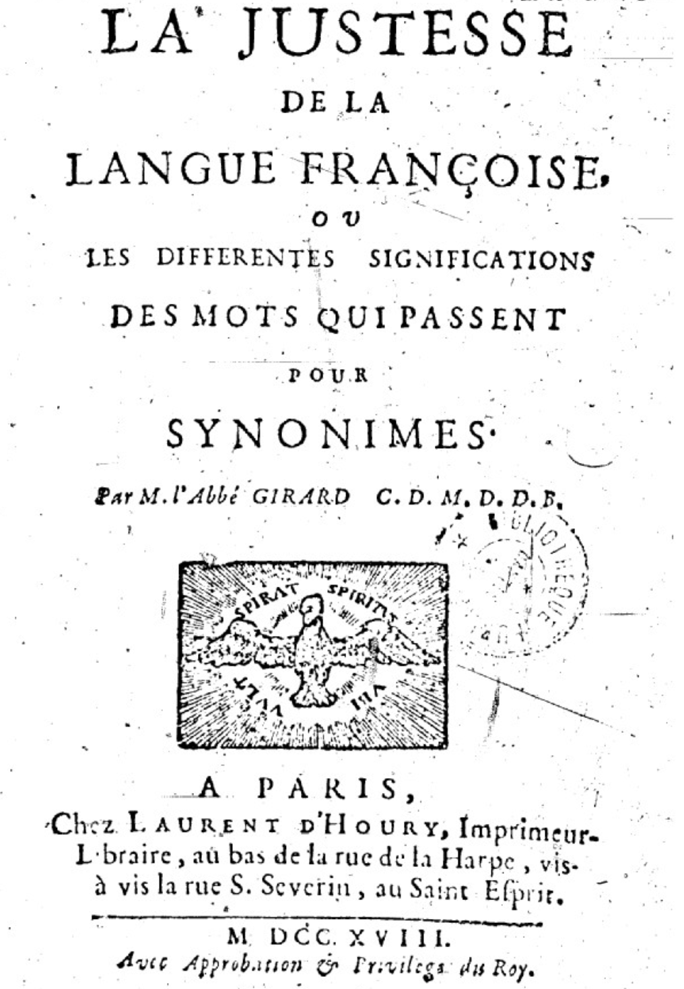
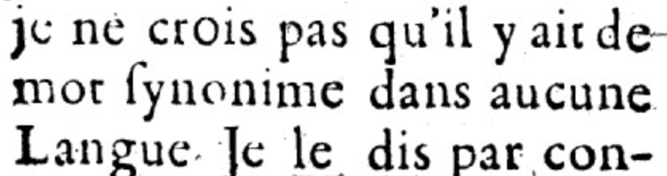
Abbé Gabriel Girard 1718
Re: "exact" synonyms
"
"
[I do not believe that there is a synonymous word in any language]
Thanks to Mark Aronoff!
Notes:
One of the fundamental tenets of semantics, called the principle of contrast, states that a difference in linguistic form is always associated with some difference in meaning.

Slide 10
Relation: Similarity
Words with similar meanings. Not synonyms, but sharing some element of meaning
car, bicycle
cow, horse
Notes:
While words don’t have many synonyms, most words do have lots of similar words. Cat is not a synonym of dog, but cats and dogs are certainly similar words. The notion of word similarity is very useful in larger semantic tasks. Know- ing how similar two words are can help in computing how similar the meaning of two phrases or sentences are, a very important component of natural language un- derstanding tasks like question answering, paraphrasing, and summarization.

Slide 11
Ask humans how similar 2 words are
word1 | word2 | similarity
vanish | disappear | 9.8
behave | obey | 7.3
belief | impression | 5.95
muscle | bone | 3.65
modest | flexible | 0.98
hole | agreement | 0.3
SimLex-999 dataset (Hill et al., 2015)
Notes:
One way of getting values for word similarity is to ask humans to judge how similar one word is to another. A number of datasets have resulted from such experiments. For example the SimLex-999 dataset (Hill et al., 2015) gives values on a scale from 0 to 10, from near-synonyms (vanish, disappear) to pairs that scarcely seem to have anything in common (hole, agreement):

Slide 12
Relation: Word relatedness
Also called "word association"
Words can be related in any way, perhaps via a semantic frame or field
coffee, tea: similar
coffee, cup: related, not similar
Notes:
The meaning of two words can be related in ways other than similarity. One such class of connections is called word relatedness (Budanitsky
and Hirst, 2006), also traditionally called word association in psychology. Coffee is similar to tea. But coffee is not similar to cup; they share practically no features (coffee is a plant or a beverage, while a cup is a manufactured object with a particular shape). But coffee and cup are clearly related; they are associated by co-participating in an everyday event (the event of drinking coffee out of a cup). Similarly scalpel and surgeon are not similar but are related
eventively (a surgeon tends to make use of a scalpel).

Slide 13
Semantic field
Words that
cover a particular semantic domain
bear structured relations with each other.
hospitals
surgeon, scalpel, nurse, anaesthetic, hospital
restaurants
waiter, menu, plate, food, menu, chef
houses
door, roof, kitchen, family, bed
Notes:
One common kind of relatedness between words is if they belong to the same
semantic field. A semantic field is a set of words which cover a particular semantic domain and bear structured relations with each other. For example, words might be related by being in the semantic field of hospitals (surgeon, scalpel, nurse, anes- thetic, hospital), restaurants (waiter, menu, plate, food, chef), or houses (door, roof, kitchen, family, bed).

Slide 14
Relation: Antonymy
Senses that are opposites with respect to only one feature of meaning
Otherwise, they are very similar!
dark/light short/long fast/slow rise/fall
hot/cold up/down in/out
More formally: antonyms can
define a binary opposition or be at opposite ends of a scale
long/short, fast/slow
Be reversives:
rise/fall, up/down

Slide 15
Connotation (sentiment)
Words have affective meanings
Positive connotations (happy)
Negative connotations (sad)
Connotations can be subtle:
Positive connotation: copy, replica, reproduction
Negative connotation: fake, knockoff, forgery
Evaluation (sentiment!)
Positive evaluation (great, love)
Negative evaluation (terrible, hate)
Notes:
Finally, words have affective meanings or connotations. The word connotation has different meanings in different fields, but here we use it to mean the aspects of a word’s meaning that are related to a writer or reader’s emotions, sentiment, opinions, or evaluations. For example some words have positive conno- tations (happy) while others have negative connotations (sad). Even words whose meanings are similar in other ways can vary in connotation; consider the difference in connotations between fake, knockoff, forgery, on the one hand, and copy, replica, reproduction on the other
Some words describe positive evaluation (great, love) and others neg- ative evaluation (terrible, hate). Positive or negative evaluation language is called sentiment, as we saw already, and word sentiment plays a role in important tasks like sentiment analysis, stance detection, and applications of NLP to the lan- guage of politics and consumer reviews.

Slide 16
Connotation
Osgood et al. (1957)
Words seem to vary along 3 affective dimensions:
valence: the pleasantness of the stimulus
arousal: the intensity of emotion provoked by the stimulus
dominance: the degree of control exerted by the stimulus
 | Word | Score |  | Word | Score
Valence | love | 1.000 |  | toxic | 0.008
 | happy | 1.000 |  | nightmare | 0.005
Arousal | elated | 0.960 |  | mellow | 0.069
 | frenzy | 0.965 |  | napping | 0.046
Dominance | powerful | 0.991 |  | weak | 0.045
 | leadership | 0.983 |  | empty | 0.081
Values from NRC VAD Lexicon (Mohammad 2018)
Notes:
Early work on affective meaning (Osgood et al., 1957) found that words varied along three important dimensions of affective meaning:

Slide 17
So far
Concepts or word senses
Have a complex many-to-many association with words (homonymy, multiple senses)
Have relations with each other
Synonymy
Antonymy
Similarity
Relatedness
Connotation

Slide 18
Vector Semantics & Embeddings
Word Meaning
Notes:
We've introduced some basic aspects of word meaning, which give us some desiderata for building a computational model.

Slide 19
Vector Semantics & Embeddings
Vector Semantics
Notes:
Here we introduce Vector Semantics, the standard way to represent word meaning in language processing

Slide 20
Computational models of word meaning
Can we build a theory of how to represent word meaning, that accounts for at least some of the desiderata?
We'll introduce vector semantics
The standard model in language processing!
Handles many of our goals!
Notes:
Vector semantics is the standard way to represent word meaning in NLP, helping us model many of the aspects of word meaning we saw in the previous section. The roots of the model lie in the 1950s when two big ideas converged:

Slide 21
Ludwig Wittgenstein
PI #43:
"The meaning of a word is its use in the language"
Notes:
The first draws on the philosopher Wittgenstein's idea that the meaning of a word should be tied to how it is used

Slide 22
Let's define words by their usages
One way to define "usage":
words are defined by their environments (the words around them)
Zellig Harris (1954):
If A and B have almost identical environments we say that they are synonyms.
Notes:
linguists like Joos (1950), Harris (1954), and Firth (1957) had the related idea of defining the meaning of a word by its distribution in language use, meaning its neighboring words or grammatical environments.

Slide 23
What does recent English borrowing ongchoi mean?
Suppose you see these sentences:
Ong choi is delicious sautéed with garlic.
Ong choi is superb over rice
Ong choi leaves with salty sauces
And you've also seen these:
…spinach sautéed with garlic over rice
Chard stems and leaves are delicious
Collard greens and other salty leafy greens
Conclusion:
Ongchoi is a leafy green like spinach, chard, or collard greens
We could conclude this based on words like "leaves" and "delicious" and "sauteed"
Notes:
For example, suppose you didn’t know the meaning of the word ongchoi (a recent borrowing from Cantonese) but you see it in the following contexts:
…
We can do the same thing computationally by just counting words in the context of ongchoi.

Slide 24
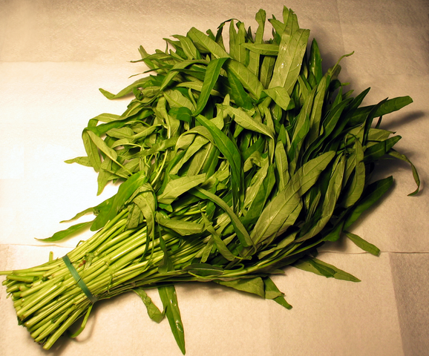
Ongchoi: Ipomoea aquatica "Water Spinach"
空心菜
kangkong
rau muống
…
Yamaguchi, Wikimedia Commons, public domain
Notes:
Here's a picture of ongchoi for you food fans

Slide 25
Idea 1: Defining meaning by linguistic distribution
Let's define the meaning of a word by its distribution in language use, meaning its neighboring words or grammatical environments.
Notes:
So we can express this first intuition as Idea 1:

Slide 26
Idea 2: Meaning as a point in space (Osgood et al. 1957)
3 affective dimensions for a word
valence: pleasantness
arousal: intensity of emotion
dominance: the degree of control exerted
Hence the connotation of a word is a vector in 3-space
 | Word | Score |  | Word | Score
Valence | love | 1.000 |  | toxic | 0.008
 | happy | 1.000 |  | nightmare | 0.005
Arousal | elated | 0.960 |  | mellow | 0.069
 | frenzy | 0.965 |  | napping | 0.046
Dominance | powerful | 0.991 |  | weak | 0.045
 | leadership | 0.983 |  | empty | 0.081
NRC VAD Lexicon
(Mohammad 2018)
Notes:
And the second idea is Osgood’s (1957) idea mentioned in the prior lecture, in which the connotation of a word is represented by 3 numbers, it's valence, arousal, and dominance. That means we are essentially representing a word's connotation by a point in three-dimensional space! But suppose we represent more than just a word's connotation

Slide 27
Idea 1: Defining meaning by linguistic distribution Idea 2: Meaning as a point in multidimensional space
Notes:
So we're going to combine these two ideas:

Slide 28
Defining meaning as a point in space based on distribution
Each word = a vector (not just "good" or "w₄₅")
Similar words are "nearby in semantic space"
We build this space automatically by seeing which words are nearby in text
Notes:
In vector semantics, we define meaning as a point in space based on distribution. Each word is a vector, not just a string like "good" or an index like "w_45". Similar words are nearby in semantic space, and, crucially, as we'll see, we build this space automatically by seeing which words are nearby in text. Here we see shows a visualization of embeddings learned for sentiment analysis, showing the location of selected words projected down from 60-dimensional space into a two dimensional space. Notice the distinct regions containing positive words, negative words, and neutral function words.

Slide 29
We define meaning of a word as a vector
Called an "embedding" because it's embedded into a space (see textbook)
The standard way to represent meaning in NLP
Every modern NLP algorithm uses embeddings as the representation of word meaning
Fine-grained model of meaning for similarity

Slide 30
Intuition: why vectors?
Consider sentiment analysis:
With words, a feature is a word identity
Feature 5: 'The previous word was "terrible"'
requires exact same word to be in training and test
With embeddings:
Feature is a word vector
'The previous word was vector [35,22,17…]
Now in the test set we might see a similar vector [34,21,14]
We can generalize to similar but unseen words!!!

Slide 31
We'll discuss 2 kinds of embeddings
tf-idf
Information Retrieval workhorse!
A common baseline model
Sparse vectors
Words are represented by (a simple function of) the counts of nearby words
Word2vec
Dense vectors
Representation is created by training a classifier to predict whether a word is likely to appear nearby
Later we'll discuss extensions called contextual embeddings

Slide 32
From now on: Computing with meaning representations instead of string representations

Slide 33
Vector Semantics & Embeddings
Vector Semantics

Slide 34
Vector Semantics & Embeddings
Words and Vectors
Notes:
Let's talk about how to represent words as simple vectors of context counts

Slide 35
Term-document matrix
Each document is represented by a vector of words
Notes:
Imagine we have a collection of documents, such as all the works of Shakespeare. We can represent documents in such a collection by a term-document matrix, in which each row represents a word in the vocabulary and each column represents a document from the collection. Here's a small selection from a term-document matrix showing the occurrence of four words in four plays by Shakespeare. Each cell in this matrix represents the number of times a particular word (defined by the row) occurs in a particular document (defined by the column). Thus fool appeared 58 times in Twelfth Night. We can think of each column as a vector representing for a document as a point in |V |-dimensional space; thus the documents in here are points in 4-dimensional space.

Slide 36
Visualizing document vectors
Notes:
A spatial visualization of the document vectors for the four Shakespeare play documents, showing just two of the dimensions, corresponding to the words battle and fool. The comedies have high values for the fool dimension and low values for the battle dimension.

Slide 37
Vectors are the basis of information retrieval
Vectors are similar for the two comedies
But comedies are different than the other two
Comedies have more fools and wit and fewer battles.
Notes:
Two documents that are similar will tend to have similar words, and if two documents have similar words their column vectors will tend to be similar. The vectors for the comedies As You Like It [1,114,36,20] and Twelfth Night [0,80,58,15] look a lot more like each other (more fools and wit than battles) than they look like Julius Caesar [7,62,1,2] or Henry V [13,89,4,3]. A real term-document matrix, of course, wouldn’t just have 4 rows and columns, let alone 2. More generally, the term-document matrix has |V| rows (one for each word type in the vocabulary) and D columns, one for each document in the collection.

Slide 38
Idea for word meaning: Words can be vectors too!!!
battle is "the kind of word that occurs in Julius Caesar and Henry V"
fool is "the kind of word that occurs in comedies, especially Twelfth Night"
Notes:
Here's the new idea: vector semantics can also be used to represent the meaning of words. We do this by associating each word with a word vector— a row vector rather than a column vector, hence with different dimensions, as we see here. The four dimensions of the vector for fool, [36,58,1,4], correspond to the four Shakespeare plays. For documents, we saw that similar documents had similar vectors, because similar documents tend to have similar words. This same principle applies to words: similar words have similar vectors because they tend to occur in similar documents. The term-document matrix thus lets us represent the meaning of a word by the documents it tends to occur in.

Slide 39
More common: word-word matrix (or "term-context matrix")
Two words are similar in meaning if their context vectors are similar
Notes:
An alternative to using the term-document matrix to represent words as vectors of document counts, is to use the term-term matrix, also called the word-word matrix or the term-context matrix, in which the columns are labeled by words rather than documents. This matrix is thus of dimensionality |V | × |V | and each cell records the number of times the row (target) word and the column (context) word co-occur in some context in some training corpus.
The context could be the document, in which case the cell represents the number of times the two words appear in the same document. It is most common, however, to use smaller contexts, generally a window around the word, for example of 4 words to the left and 4 words to the right, in which case the cell represents the number of times (in some training corpus) the column word occurs in such a ±4 word window around the row word. For example here is one example each of some words in their windows with counts from a Wikipedia corpus. Note that digital and information are more similar to each other than, say, to strawberry.

Slide 40
Notes:
Here's a spatial visualization of word vectors for digital and information, showing just two of the dimensions, corresponding to the words data and computer.
Of course in real life these vectors aren't just of length 2. |V |, the length of the vector, is generally the size of the vocabulary, of- ten between 10,000 and 50,000 words (using the most frequent words in the training corpus; keeping words after about the most frequent 50,000 or so is generally not helpful). Since most of these numbers are zero these are sparse vector representations; there are efficient algorithms for storing and computing with sparse matrices.

Slide 41
Vector Semantics & Embeddings
Words and Vectors
Notes:
We've seen that a word can be simply represented as a vector of counts, a fundamental idea that underlies all embedding representations.

Slide 42
Vector Semantics & Embeddings
Cosine for computing word similarity
Notes:
. To measure similarity between two words, we need a metric that compares two vectors. By far the most common similarity metric is the cosine of the angle between the vectors.

Slide 43
Computing word similarity: Dot product and cosine
The dot product between two vectors is a scalar:
The dot product tends to be high when the two vectors have large values in the same dimensions
Dot product can thus be a useful similarity metric between vectors
Notes:
The cosine—like most measures for vector similarity used in NLP—is based on the dot product operator from linear algebra, also called the inner product in which we multiply the vectors elementwise and add up to get a scalar value. The dot product acts as a similarity metric because it will tend to be high just when the two vectors have large values in the same dimensions. Alternatively, vectors that have zeros in different dimensions—orthogonal vectors—will have a dot product of 0, representing their strong dissimilarity.

Slide 44
Problem with raw dot-product
Dot product favors long vectors
Dot product is higher if a vector is longer (has higher values in many dimension)
Vector length:
Frequent words (of, the, you) have long vectors (since they occur many times with other words).
So dot product overly favors frequent words
Notes:
This raw dot product, however, has a problem as a similarity metric: it favors long vectors. The vector length is defined as the square root of the sum of the square of the values
The dot product is higher if a vector is longer, with higher values in each dimension. More frequent words have longer vectors, since they tend to co-occur with more words and have higher co-occurrence values with each of them. The raw dot product thus will be higher for frequent words. But this is a problem; we’d like a similarity metric that tells us how similar two words are regardless of their frequency.

Slide 45
Alternative: cosine for computing word similarity
Based on the definition of the dot product between two vectors a and b
Notes:
We modify the dot product to normalize for the vector length by dividing the dot product by the lengths of each of the two vectors. This normalized dot product turns out to be the same as the cosine of the angle between the two vectors (Geometrically, it is the product of the Euclidean magnitudes of the two vectors and the cosine of the angle between them).

Slide 46
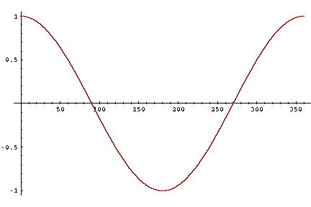
Cosine as a similarity metric
-1: vectors point in opposite directions
+1: vectors point in same directions
0: vectors are orthogonal
But since raw frequency values are non-negative, the cosine for term-term matrix vectors ranges from 0–1
Notes:
The cosine value ranges from 1 for vectors pointing in the same direction, through 0 for orthogonal vectors, to -1 for vectors pointing in opposite directions. But since raw frequency values are non-negative, the cosine for these vectors ranges from 0–1.

Slide 47
Cosine examples
 | pie | data | computer
cherry | 442 | 8 | 2
digital | 5 | 1683 | 1670
information | 5 | 3982 | 3325
Notes:
Let’s see how the cosine computes which of the words cherry or digital is closer in meaning to information, just using raw counts from the following shortened table.
The model decides that information is way closer to digital than it is to cherry, a result that seems sensible.

Slide 48
Visualizing cosines (well, angles)
Notes:
Here's a rough graphical demonstration of cosine similarity, showing vectors for the words cherry, digital, and information in the two dimensional space defined by counts of the words computer and pie nearby. Note that the angle between digital and information is smaller than the angle between cherry and information. When two vectors are more similar, the cosine is larger but the angle is smaller; the cosine has its maximum (1) when the angle between two vectors is smallest (0◦); the cosine of all other angles is less than 1.

Slide 49
Vector Semantics & Embeddings
Cosine for computing word similarity
Notes:
We've seen in detail the vector cosine, the most common algorithm for computing word similarity.

Slide 50
Vector Semantics & Embeddings
TF-IDF
Notes:
Here we introduce tf-idf weighting, a common way to reweight counts in term-document matrices

Slide 51
But raw frequency is a bad representation
The co-occurrence matrices we have seen represent each cell by word frequencies.
Frequency is clearly useful; if sugar appears a lot near apricot, that's useful information.
But overly frequent words like the, it, or they are not very informative about the context
It's a paradox! How can we balance these two conflicting constraints?
Notes:
The co-occurrence matrices we've been using represent each cell by frequencies of words with other words or documents. But raw frequency is is very skewed and not very discriminative. If sugar appears a lot near apricot, that's useful information. But words like the, or it, which occur frequently with all sorts of words, aren’t informative about any particular word . It’s a bit of a paradox. How can we balance these two conflicting constraints?

Slide 52
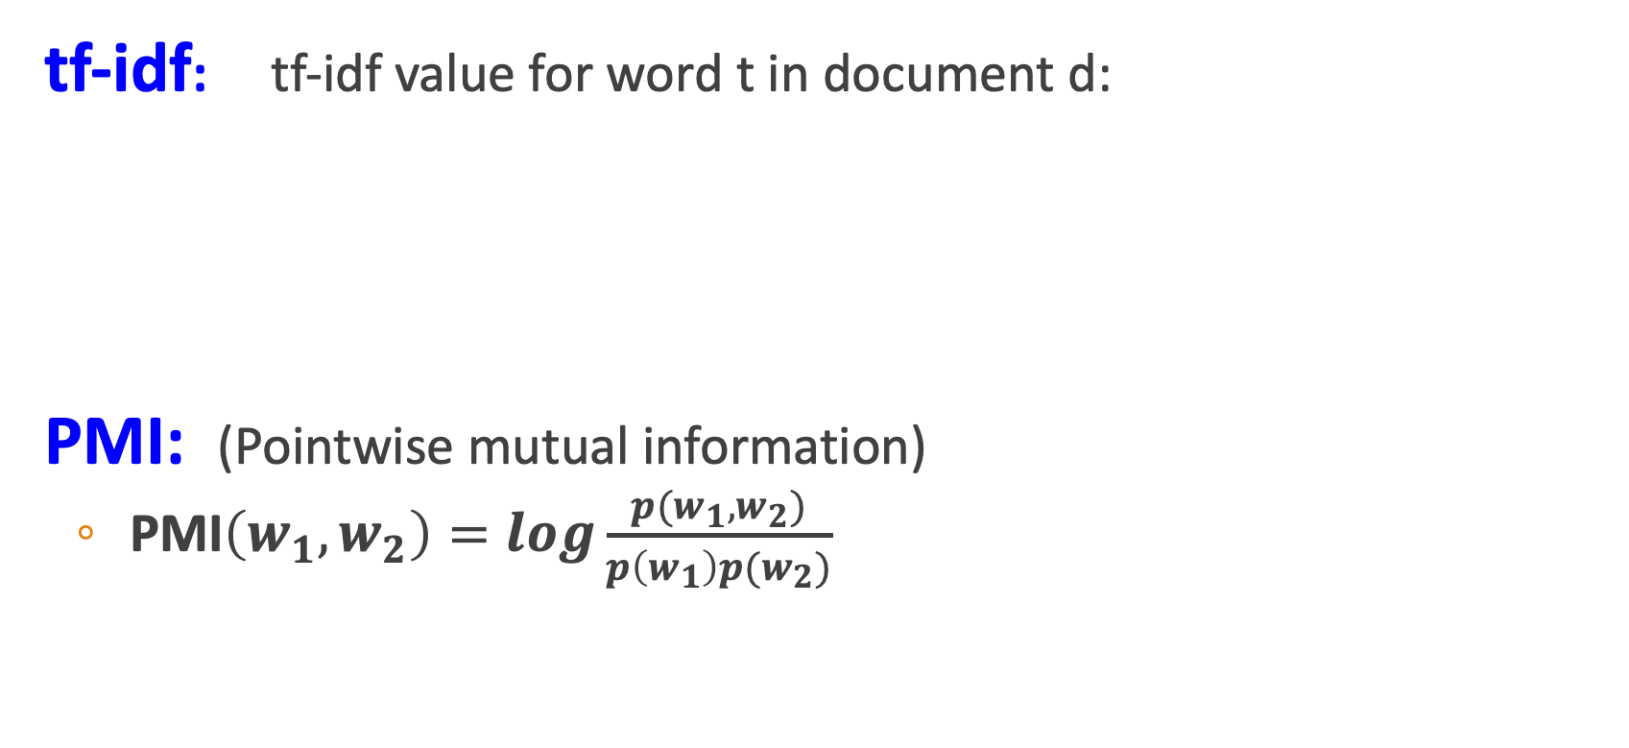
Two common solutions for word weighting
tf-idf: tf-idf value for word t in document d:
PMI: (Pointwise mutual information)
$\text{PMI}\left(w_{1},w_{2}\right)=log\frac{p(w_{1},w_{2})}{p\left(w_{1}\right)p(w_{2})}$
Words like "the" or "it" have very low idf
See if words like "good" appear more often with "great" than we would expect by chance
Notes:
There are two common solutions to this problem: the tf-idf algorithm, usually used when the dimensions are documents, and algorithms based on pointwise mutual information, or PMI (usually used when the dimensions are words). Tf-idf makes use of a special weight call the "inverse document frequency or "idf", to downweight words like "the" or "it". PMI is a statistical measure that compares the probabilities we see with what we would have expected by change.

Slide 53
Term frequency (tf)
tf_{t,d} = count(t,d)
Instead of using raw count, we squash a bit:
tf_{t,d} = log₁₀(count(t,d)+1)
Notes:
The tf-idf algorithm (the ‘-’ here is a hyphen, not a minus sign) is the product of two terms, each term capturing one of these two intuitions. The first is the term frequency: the frequency of the word t in the document d. We can just use the raw count as the term frequency: EQ
More commonly we squash the raw frequency a bit, by using the log10 of the fre- quency instead. The intuition is that a word appearing 100 times in a document doesn’t make that word 100 times more likely to be relevant to the meaning of the document. Because we can’t take the log of 0, we normally add 1 to the count:

Slide 54
Document frequency (df)
df_{t} is the number of documents t occurs in.
(note this is not collection frequency: total count across all documents)
"Romeo" is very distinctive for one Shakespeare play:
Notes:
The second factor in tf-idf is used to give a higher weight to words that occur only in a few documents. Terms that are limited to a few documents are useful for discriminating those documents from the rest of the collection; terms that occur frequently across the entire collection aren’t as helpful. The document frequency dft of a term t is the number of documents it occurs in .
Document frequency is not the same as the collection frequency of a term, which is the total number of times the word appears in the whole collection in any document. Consider in the collection of Shakespeare’s 37 plays the two words Romeo and action. The words have identical collection frequencies (they both occur 113 times in all the plays) but very different document frequencies, since Romeo only occurs in a single play. If our goal is to find documents about the romantic tribulations of Romeo, the word Romeo should be highly weighted, but not action:
Important: documents can be anything, they don't have to be original documents. For example we often treat each paragraph as a document, which lets use compute tf-idf values for

Slide 55
Inverse document frequency (idf)
N is the total number of documents
in the collection
Notes:
We emphasize discriminative words like Romeo via the inverse document fre- quency or idf term weight (Sparck Jones, 1972). The idf is defined using the frac- tion N/dft, where N is the total number of documents in the collection, and dft is the number of documents in which term t occurs. The fewer documents in which a term occurs, the higher this weight. The lowest weight of 1 is assigned to terms that occur in all the documents. Because of the large number of documents in many collections, this measure too is usually squashed with a log function. The resulting definition for inverse document frequency (idf) is thus
Here are some idf values for some words in the Shakespeare corpus, ranging from extremely informative words which occur in only one play like Romeo, to those that occur in a few like salad or Falstaff, to those which are very common like fool or so common as to be completely non-discriminative since they occur in all 37 plays like good or sweet.

Slide 56
What is a document?
Could be a play or a Wikipedia article
But for the purposes of tf-idf, documents can be anything; we often call each paragraph a document!
Notes:
It’s usually clear what counts as a document: in Shake-speare we would use a play; when processing a collection of encyclopedia articles like Wikipedia, the document is a Wikipedia page; in processing newspaper articles, the document is a single article. But very frequently you might need to break up the corpus into documents yourself for the purposes of computing idf. Because that documents can be anything, they don't have to be original documents. For example we often treat each paragraph as a document, which lets use compute tf-idf values even when we are dealing say with a single document like a book.

Slide 57
Final tf-idf weighted value for a word
Raw counts:
tf-idf:
Notes:
The tf-idf weighted value wt,d for word t in document d thus combines term
frequency tft,d with idf:
Here's the raw counts in the Shakespeare term-document matrix, and the tf-idf weighted version of the same matrix.. Note that the tf-idf values for the dimension corresponding to the word good have now all become 0; since this word appears in every document, the tf-idf algorithm leads it to be ignored. Similarly, the word fool, which appears in 36 out of the 37 plays, has a much lower weight.

Slide 58
Vector Semantics & Embeddings
TF-IDF
Notes:
We've seen how to use tf-idf weights to computing weighted vectors representing word.

Slide 59
Vector Semantics & Embeddings
PPMI

Slide 60
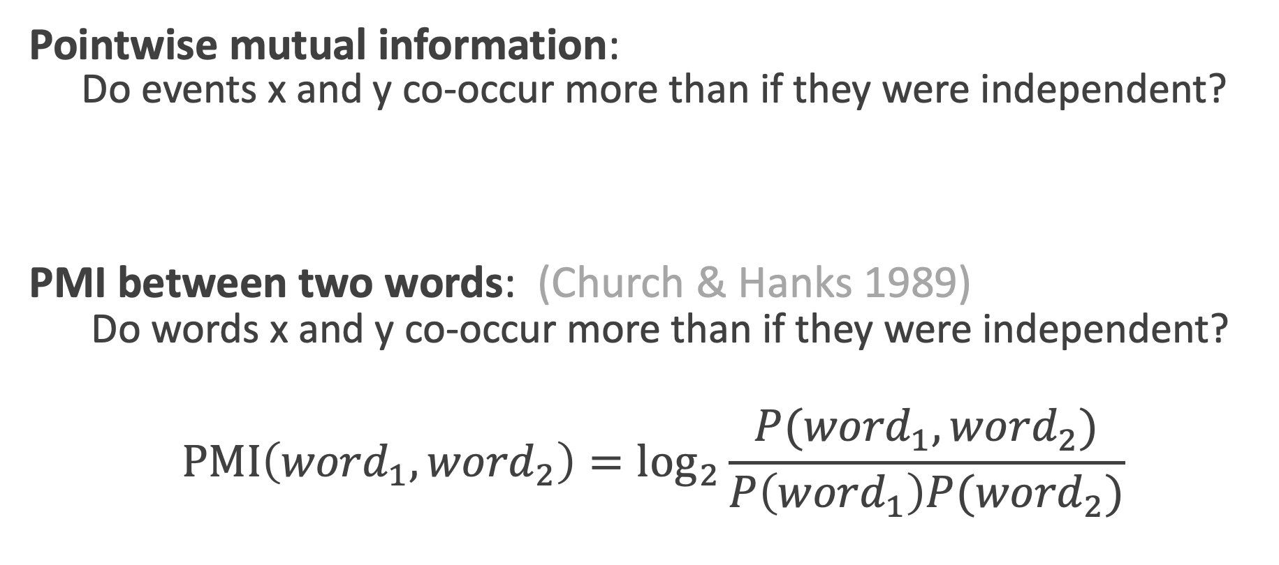
Pointwise Mutual Information
Pointwise mutual information:
Do events x and y co-occur more than if they were independent?
PMI between two words: (Church & Hanks 1989)
Do words x and y co-occur more than if they were independent?
$$\text{PMI}\left({word}_{1}, {word}_{2}\right)={\text{log}}_{2}\frac{P({word}_{1}, {word}_{2})}{P\left({word}_{1}\right)P({word}_{2})}$$

Slide 61
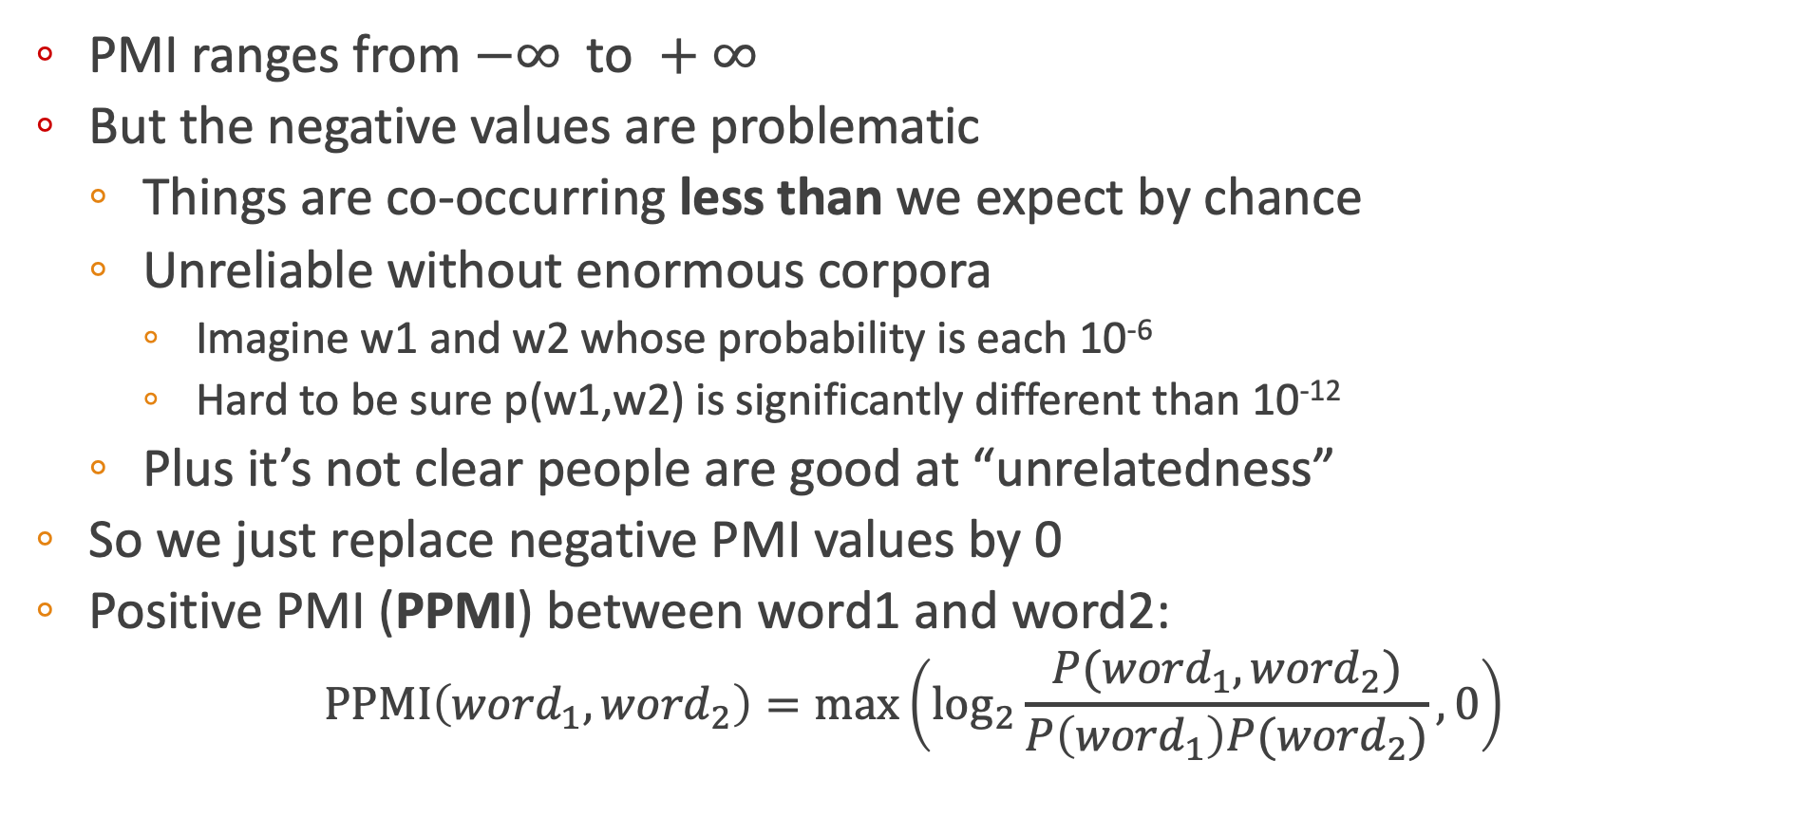
Positive Pointwise Mutual Information
PMI ranges from $−∞ \text{to} +∞$
But the negative values are problematic
Things are co-occurring less than we expect by chance
Unreliable without enormous corpora
Imagine w1 and w2 whose probability is each 10⁻⁶
Hard to be sure p(w1,w2) is significantly different than 10⁻¹²
Plus it’s not clear people are good at “unrelatedness”
So we just replace negative PMI values by 0
Positive PMI (PPMI) between word1 and word2:
$$\text{PPMI}\left({word}_{1}, {word}_{2}\right)=\max\left({\text{log}}_{2}\frac{P({word}_{1}, {word}_{2})}{P\left({word}_{1}\right)P({word}_{2})},0\right)$$

Slide 62
Computing PPMI on a term-context matrix
Matrix F with W rows (words) and C columns (contexts)
f_{ij} is # of times w_{i} occurs in context c_{j}

Slide 63
p(w=information,c=data) =
p(w=information) =
p(c=data) =
3982/11716
= .3399
7703/11716
= .6575
5673/11716
= .4842

Slide 64
pmi(information,data) = log₂ (
.3399 /
(.6575*.4842) )
= .0944
Resulting PPMI matrix (negatives replaced by 0)

Slide 65
Weighting PMI
PMI is biased toward infrequent events
Very rare words have very high PMI values
Two solutions:
Give rare words slightly higher probabilities
Use add-one smoothing (which has a similar effect)

Slide 66
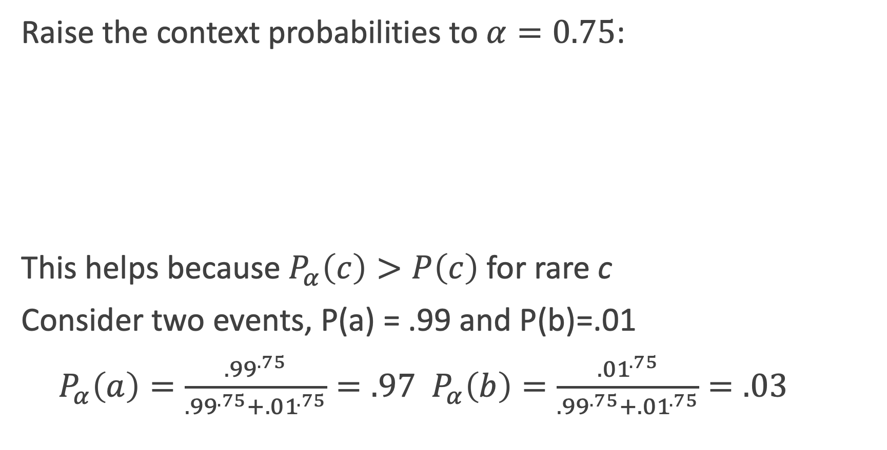
Weighting PMI: Giving rare context words slightly higher probability
Raise the context probabilities to $α=0.75$:
This helps because $P_{α}\left(c\right)>P\left(c\right)$ for rare c
Consider two events, P(a) = .99 and P(b)=.01
${ P}_{α}\left(a\right)=\frac{{.99}^{.75}}{{.99}^{.75}+{.01}^{.75}}=.97$ $P_{α}\left(b\right)=\frac{{.01}^{.75}}{{.99}^{.75}+{.01}^{.75}}=.03$

Slide 67
Vector Semantics & Embeddings
Word2vec
Notes:
Let's now introduce the important word2vec embeddings.

Slide 68
Sparse versus dense vectors
tf-idf (or PMI) vectors are
long (length |V|= 20,000 to 50,000)
sparse (most elements are zero)
Alternative: learn vectors which are
short (length 50-1000)
dense (most elements are non-zero)
Notes:
In the previous lectures we saw how to represent a word as a sparse, long vector with dimensions corresponding to words in the vocabulary or documents in a collection. We now introduce a more powerful word representation: embeddings, short dense vectors. Unlike the vectors we’ve seen so far, embeddings are short, with number of dimensions d ranging from 50-1000, rather than the much larger vocabulary size |V | or number of documents D we’ve seen. These d dimensions don’t have a clear interpretation. And the vectors are dense: instead of vector entries being sparse, mostly-zero counts or functions of counts, the values will be real-valued numbers that can be negative.

Slide 69
Sparse versus dense vectors
Why dense vectors?
Short vectors may be easier to use as features in machine learning (fewer weights to tune)
Dense vectors may generalize better than explicit counts
Dense vectors may do better at capturing synonymy:
car and automobile are synonyms; but are distinct dimensions
a word with car as a neighbor and a word with automobile as a neighbor should be similar, but aren't
In practice, they work better**
Notes:
It turns out that dense vectors work better in every NLP task than sparse vectors. While we don’t completely understand all the reasons for this, we have some intu- itions. Representing words as 700-dimensional dense vectors requires our classifiers to learn far fewer weights than if we represented words as 50,000-dimensional vec- tors, and the smaller parameter space possibly helps with generalization and avoid- ing overfitting. Dense vectors may also do a better job of capturing synonymy. For example, in a sparse vector representation, dimensions for synonyms like car and automobile dimension are distinct and unrelated; sparse vectors may thus fail to capture the similarity between a word with car as a neighbor and a word with automobile as a neighbo

Slide 70
Common methods for getting short dense vectors
“Neural Language Model”-inspired models
Word2vec (skipgram, CBOW), GloVe
Singular Value Decomposition (SVD)
A special case of this is called LSA – Latent Semantic Analysis
Alternative to these "static embeddings":
Contextual Embeddings (ELMo, BERT)
Compute distinct embeddings for a word in its context
Separate embeddings for each token of a word
Notes:
In this section we introduce one method for computing embeddings: skip-gram with negative sampling, sometimes called SGNS. The skip-gram algorithm is one of two algorithms in a software package called word2vec, and so sometimes the al- gorithm is loosely referred to as word2vec. The word2vec methods are fast, efficient to train, and easily available online with code and pretrained embeddings. Word2vec embeddings are static embeddings, meaning that the method learns one fixed embedding for each word in the vocabulary. An lternative to these static embeddings are more recent methods for learning dynamic contextual em-beddings like the popular BERT representations, in which the vector for each word is different in different contexts.

Slide 71
Simple static embeddings you can download!
Word2vec (Mikolov et al)
https://code.google.com/archive/p/word2vec/
GloVe (Pennington, Socher, Manning)
http://nlp.stanford.edu/projects/glove/

Slide 72
Word2vec
Popular embedding method
Very fast to train
Code available on the web
Idea: predict rather than count
Word2vec provides various options. We'll do:
skip-gram with negative sampling (SGNS)

Slide 73
Word2vec
Instead of counting how often each word w occurs near "apricot"
Train a classifier on a binary prediction task:
Is w likely to show up near "apricot"?
We don’t actually care about this task
But we'll take the learned classifier weights as the word embeddings
Big idea: self-supervision:
A word c that occurs near apricot in the corpus cats as the gold "correct answer" for supervised learning
No need for human labels
Bengio et al. (2003); Collobert et al. (2011)
Notes:
The intuition of word2vec is that instead of counting how often each word w oc- curs near, say, apricot, we’ll instead train a classifier on a binary prediction task: “Is word w likely to show up near apricot?” We don’t actually care about this prediction task; instead we’ll take the learned classifier weights as the word embeddings. The revolutionary intuition here is that we can just use running text as implicitly supervised training data for such a classifier; a word c that occurs near the target word apricot acts as gold ‘correct answer’ to the question “Is word c likely to show up near apricot?” This method, often called self-supervision, avoids the need for any sort of hand-labeled supervision signal. This idea was first proposed in the task of neural language modeling, when Bengio et al. (2003) and Collobert et al. (2011) showed that a neural language model (a neural network that learned to predict the next word from prior words) could just use the next word in running text as its supervision signal, and could be used to learn an embedding representation for each word as part of doing this prediction task. word2vec is a much simpler model than the neural network language model, in two ways. First, word2vec simplifies the task (making it binary classification instead of word pre- diction). Second, word2vec simplifies the architecture (training a logistic regression classifier instead of a multi-layer neural network with hidden layers that demand more sophisticated training algorithms)

Slide 74
Approach: predict if candidate word c is a "neighbor"
Treat the target word t and a neighboring context word c as positive examples.
Randomly sample other words in the lexicon to get negative examples
Use logistic regression to train a classifier to distinguish those two cases
Use the learned weights as the embeddings
Notes:
The intuition of skip-gram is:

Slide 75
Skip-Gram Training Data
Assume a +/- 2 word window, given training sentence:
…lemon, a [tablespoon of apricot jam, a] pinch…
c1 c2 c3 c4
[target]
Notes:
Let’s start by thinking about the classification task, and then turn to how to train. Imagine a sentence like the following, with a target word apricot, and assume we’re using a window of ±2 context words:

Slide 76
Skip-Gram Classifier
(assuming a +/- 2 word window)
…lemon, a [tablespoon of apricot jam, a] pinch…
c1 c2 [target] c3 c4
Goal: train a classifier that is given a candidate (word, context) pair
(apricot, jam)
(apricot, aardvark)
…
And assigns each pair a probability:
P(+|w, c)
P(−|w, c) = 1 − P(+|w, c)
Notes:
Our goal is to train a classifier such that, given a tuple (w,c) of a target word w paired with a candidate context word c (for example (apricot, jam), or perhaps (apricot, aardvark)) it will return the probability that c is a real context word (true for jam, false for aardvark):
The probability that word c is not a real context word for w is just 1 minus

Slide 77
Similarity is computed from dot product
Remember: two vectors are similar if they have a high dot product
Cosine is just a normalized dot product
So:
Similarity(w,c) ∝ w ∙ c
We’ll need to normalize to get a probability
(cosine isn't a probability either)
Notes:
he intuition of the skip- gram model is to base this probability on embedding similarity: a word is likely to occur near the target if its embedding is similar to the target embedding. To compute similarity between these dense embeddings, we rely on the intuition that two vectors are similar if they have a high dot product (after all, cosine is just a normalized dot product). In other words: Similarity(w,c) ∝ w ∙ c

Slide 78
Turning dot products into probabilities
Sim(w,c) ≈ w ∙ c
To turn this into a probability
We'll use the sigmoid from logistic regression:
Notes:
The dot product c · w is not a probability, it’s just a number ranging from −∞ to ∞ (since the elements in word2vec embeddings can be negative, the dot product can be negative). To turn the dot product into a probability, we’ll use the logistic or sigmoid function σ (x) from logistic regression
We model the probability that word c is a real context word for target word w as:
to make it a probability we’ll also need the total probability of the two possible events (c is a context word, and c isn’t a context word) to sum to 1. We thus estimate the probability that word c is not a real context word for w as:

Slide 79
How Skip-Gram Classifier computes P(+|w, c)
This is for one context word, but we have lots of context words.
We'll assume independence and just multiply them:
Notes:
This equation gives us the probability for one word, but there are many context words in the window. Skip-gram makes the simplifying assumption that all context words are independent, allowing us to just multiply their probabilities:

Slide 80
Skip-gram classifier: summary
A probabilistic classifier, given
a test target word w
its context window of L words c_{1:L}
Estimates probability that w occurs in this window based on similarity of w (embeddings) to c_{1:L} (embeddings).
To compute this, we just need embeddings for all the words.
Notes:
In summary, skip-gram trains a probabilistic classifier that, given a test target word w and its context window of L words c1:L, assigns a probability based on how similar this context window is to the target word. The probability is based on applying the logistic (sigmoid) function to the dot product of the embeddings of the target word with each context word. To compute this probability, we just need embeddings for each target word and context word in the vocabulary.

Slide 81
These embeddings we'll need: a set for w, a set for c
Notes:
Here's the intuition of parameters we’ll need. Skip-gram actually stores two embeddings for each word, one for the word as a target, and one for the word considered as context. Thus the parameters we need to learn are two matrices W and C, each containing an embedding for every one of the |V | words in the vocbulary

Slide 82
Vector Semantics & Embeddings
Word2vec
Notes:
We've seen how the skipgram classifier functions. In the next section we'll turn to learning its weights, which is the goal of building the classifier

Slide 83
Vector Semantics & Embeddings
Word2vec: Learning the embeddings
Notes:
Let's see how word2vec uses sigmoids and gradient descent to learn embeddings

Slide 84
Skip-Gram Training data
…lemon, a [tablespoon of apricot jam, a] pinch…
c1 c2 [target] c3 c4
Notes:
Skip-gram learns embeddings by starting with random embedding vectors and then iteratively shifting the embedding of each word w to be more like the embeddings of words that occur nearby in texts, and less like the embeddings of words that don’t occur nearby. Let’s start by considering a single piece of training data
This example has a target word w (apricot), and 4 context words in the L = ±2 window, resulting in 4 positive training instances (on the left below):

Slide 85
Skip-Gram Training data
…lemon, a [tablespoon of apricot jam, a] pinch…
c1 c2 [target] c3 c4
For each positive example we'll grab k negative examples, sampling by frequency
Notes:
For training a binary classifier we also need negative examples. In fact skip- gram with negative sampling (SGNS) uses more negative examples than positive examples (with the ratio between them set by a parameter k). So for each of these (w,cpos) training instances we’ll create k negative samples, each consisting of the target w plus a ‘noise word’ cneg. A noise word is a random word from the lexicon, constrained not to be the target word w.

Slide 86
Skip-Gram Training data
…lemon, a [tablespoon of apricot jam, a] pinch…
c1 c2 [target] c3 c4
Notes:
Here's the setting where k = 2, so we’ll have 2 negative examples in the negative training set − for each positive example w,cpos. The noise words are chosen according to their weighted unigram frequency.

Slide 87
Word2vec: how to learn vectors
Given the set of positive and negative training instances, and an initial set of embedding vectors
The goal of learning is to adjust those word vectors such that we:
Maximize the similarity of the target word, context word pairs (w , c_{pos}) drawn from the positive data
Minimize the similarity of the (w , c_{neg}) pairs drawn from the negative data.
Notes:
Given the set of positive and negative training instances, and an initial set of embeddings, the goal of the learning algorithm is to adjust those embeddings to
• Maximize the similarity of the target word, context word pairs (w,cpos) drawn from the positive examples
• Minimize the similarity of the (w,cneg) pairs from the negative examples.

Slide 88
Loss function for one w with c_{pos} , c_{neg1} ...c_{negk}
Maximize the similarity of the target with the actual context words, and minimize the similarity of the target with the k negative sampled non-neighbor words.
Notes:
If we consider one word/context pair (w, cpos ) with its k noise words cneg1 ...cnegk , our goal is to maximize the similarity of the target with the actual context words, andn minimize the similarity of the target with the k negative sampled non-neighbor words. We can express these two goals as the following loss function L to be minimized (hence the −); here the first term expresses that we want the classifier to assign the real context word cpos a high probability of being a neighbor, and the second term expresses that we want to assign each of the noise words cnegi a high probability of being a non-neighbor, all multiplied because we assume independence:
If we substitute in our sigmoid of the dot product estimate for P, we want to maximize the dot product of the word with the actual context words, and minimize the dot products of the word with the k negative sampled non- neighbor words.
􏰼

Slide 89
Learning the classifier
How to learn?
Stochastic gradient descent!
We’ll adjust the word weights to
make the positive pairs more likely
and the negative pairs less likely,
over the entire training set.
Notes:
We minimize this loss function using stochastic gradient descent.

Slide 90
Intuition of one step of gradient descent
Notes:
Let's look at the intuition of one step of gradient descent. The skip-gram model tries to shift embeddings so the target embeddings (here for apricot) are closer to (have a higher dot product with) context embeddings for nearby words (here jam) and further from (lower dot product with) context embeddings for noise words that don’t occur nearby (here Tolstoy and matrix).

Slide 91
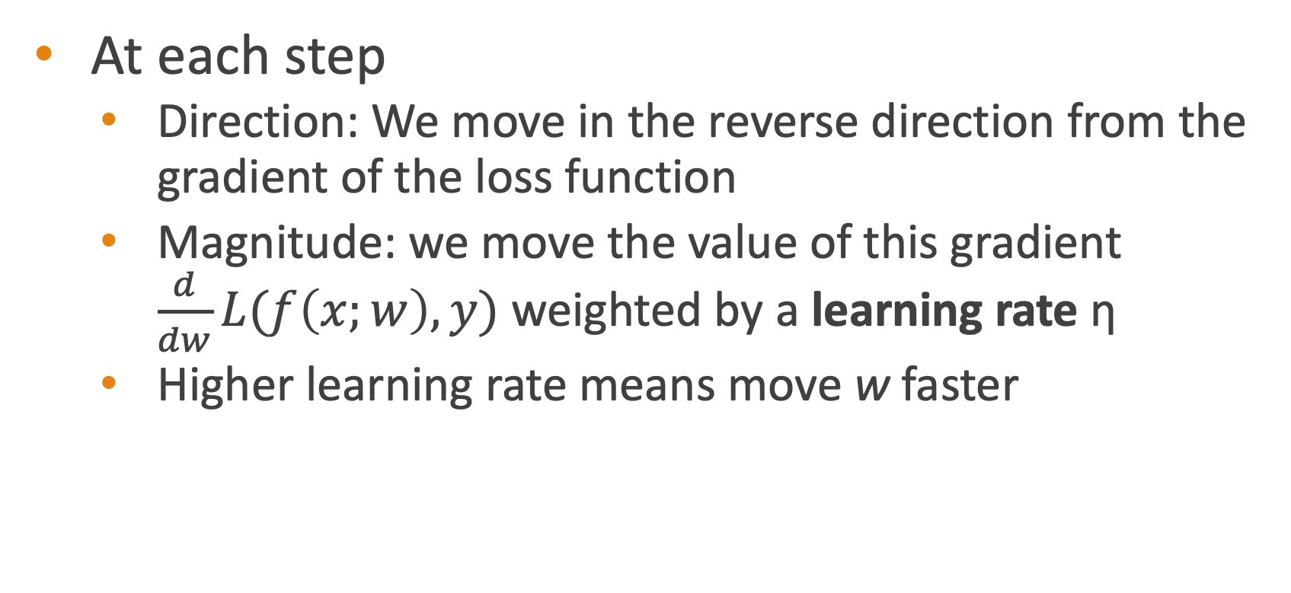
Reminder: gradient descent
At each step
Direction: We move in the reverse direction from the gradient of the loss function
Magnitude: we move the value of this gradient $\frac{d}{dw}L(f\left(x;w\right),y)$ weighted by a learning rate η
Higher learning rate means move w faster

Slide 92
The derivatives of the loss function
Notes:
To get the gradient, we need to take the derivative of this equation with respect to the different embeddings. We'll need a derivate for the C embeddings and for the W embeddings. And we'll want a different derivative for the weights for the positive context examples and the nevative context examples, since we want to move them in opposite directions. It turns out the derivatives are the following elegant functions.

Slide 93
Update equation in SGD
Start with randomly initialized C and W matrices, then incrementally do updates
Notes:
The update equations going from time step t to t + 1 in stochastic gradient descent are thus:
Just as in logistic regression, then, the learning algorithm starts with randomly initialized W and C matrices, and then walks through the training corpus using gradient descent to move W and C so as to maximize the objective we saw earlier by making the updates here.

Slide 94
Two sets of embeddings
SGNS learns two sets of embeddings
Target embeddings matrix W
Context embedding matrix C
It's common to just add them together, representing word i as the vector w_{i} + c_{i}
Notes:
As we've just seen, the skip-gram model learns two separate embeddings for each word i: the target embedding w and the context embedding c , stored in two matrices, the target matrix W and the context matrix C. Ibut if we just need one vector to represent a word, what should we use? t’s common to just add them together, representing word i with the vector wi + ci .

Slide 95
Summary: How to learn word2vec (skip-gram) embeddings
Start with V random d-dimensional vectors as initial embeddings
Train a classifier based on embedding similarity
Take a corpus and take pairs of words that co-occur as positive examples
Take pairs of words that don't co-occur as negative examples
Train the classifier to distinguish these by slowly adjusting all the embeddings to improve the classifier performance
Throw away the classifier code and keep the embeddings.

Slide 96
Vector Semantics & Embeddings
Word2vec: Learning the embeddings
Notes:
We've seen how to learn word2vec embeddings, one of the most popular static embedding method

Slide 97
Vector Semantics & Embeddings
Properties of Embeddings
Notes:
Let's talk about various properties and parameters of embeddings

Slide 98
The kinds of neighbors depend on window size
Small windows (C= +/- 2) : nearest words are syntactically similar words in same taxonomy
Hogwarts nearest neighbors are other fictional schools
Sunnydale, Evernight, Blandings
Large windows (C= +/- 5) : nearest words are related words in same semantic field
Hogwarts nearest neighbors are Harry Potter world:
Dumbledore, half-blood, Malfoy
Notes:
One parameter of vector semantic models that is relevant to both sparse tf-idf vectors and dense word2vec vectors is the size of the context window used to collect counts. This is generally between 1 and 10 words on each side of the target word (for a total context of 2-20 words).
The choice depends on the goals of the representation. Shorter context windows tend to lead to representations that are a bit more syntactic, since the information is coming from immediately nearby words. When the vectors are computed from short context windows, the most similar words to a target word w tend to be semantically similar words with the same parts of speech. When vectors are computed from long context windows, the highest cosine words to a target word w tend to be words that are topically related but not similar. For example Levy and Goldberg (2014a) showed that using skip-gram with a window of ±2, the most similar words to the word Hogwarts (from the Harry Potter series) were names of other fictional schools: Sunnydale (from Buffy the Vampire Slayer) or Evernight (from a vampire series). With a window of ±5, the most similar words to Hogwarts were other words topically related to the Harry Potter series: Dumbledore, Malfoy, and half-blood.

Slide 99
Analogical relations
The classic parallelogram model of analogical reasoning (Rumelhart and Abrahamson 1973)
To solve: "apple is to tree as grape is to _____"
Add tree – apple to grape to get vine
Notes:
Another semantic property of embeddings is their ability to capture relational meanings. In an important early vector space model of cognition, Rumelhart and Abrahamson (1973) proposed the parallelogram model for solving simple analogy problems of the form a is to b as a* is to what?. In such problems, a system given a problem like apple:tree::grape:?, i.e., apple is to tree as grape is to , and must fill in the word vine.
In the parallelogram model, the vector from the word apple ito the word tree (= apple − tree)
is added to the vector for grape (grape); the nearest word to that point is returned

Slide 100
Analogical relations via parallelogram
The parallelogram method can solve analogies with both sparse and dense embeddings (Turney and Littman 2005, Mikolov et al. 2013b)
king – man + woman is close to queen
Paris – France + Italy is close to Rome
For a problem a:a*::b:b*, the parallelogram method is:
Notes:
For a a:b::a*:b* problem, meaning the algorithm is given a, b, and a* and must find b*, the parallelogram method is thus: EQUATION
with the distance function defined either as cosine or as Euclidean distance.

Slide 101
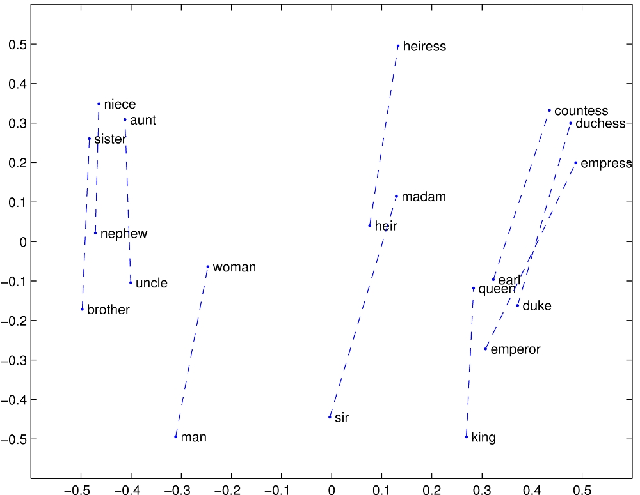
Structure in GloVE Embedding space

Slide 102
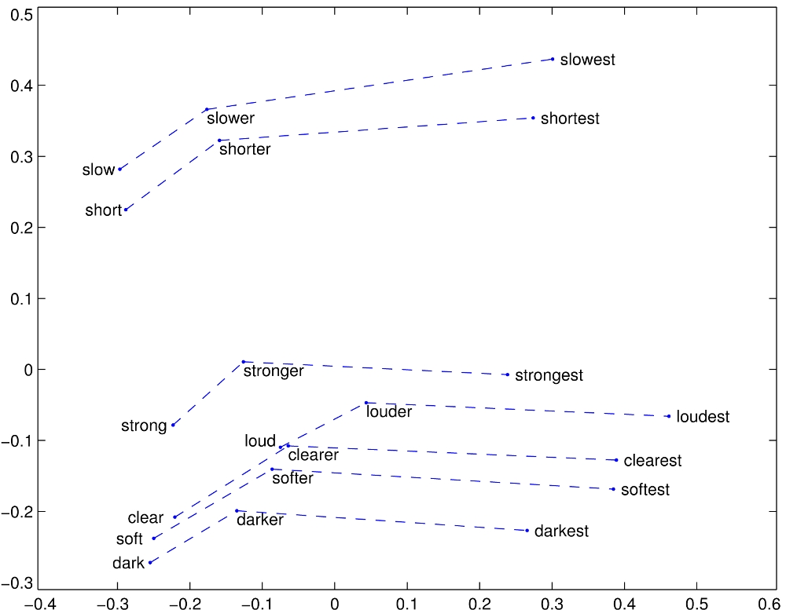

Slide 103
Caveats with the parallelogram method
It only seems to work for frequent words, small distances and certain relations (relating countries to capitals, or parts of speech), but not others. (Linzen 2016, Gladkova et al. 2016, Ethayarajh et al. 2019a)
Understanding analogy is an open area of research (Peterson et al. 2020)

Slide 104

Embeddings can help study word history!
Train embeddings on old books to study changes in word meaning!!
Will Hamilton

Slide 105


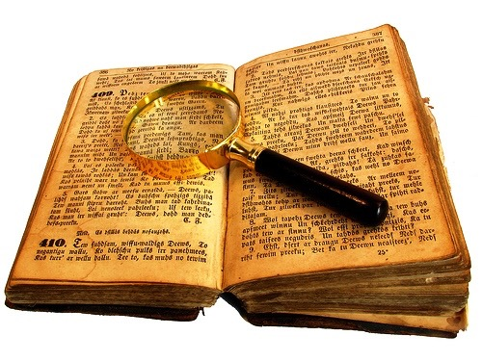
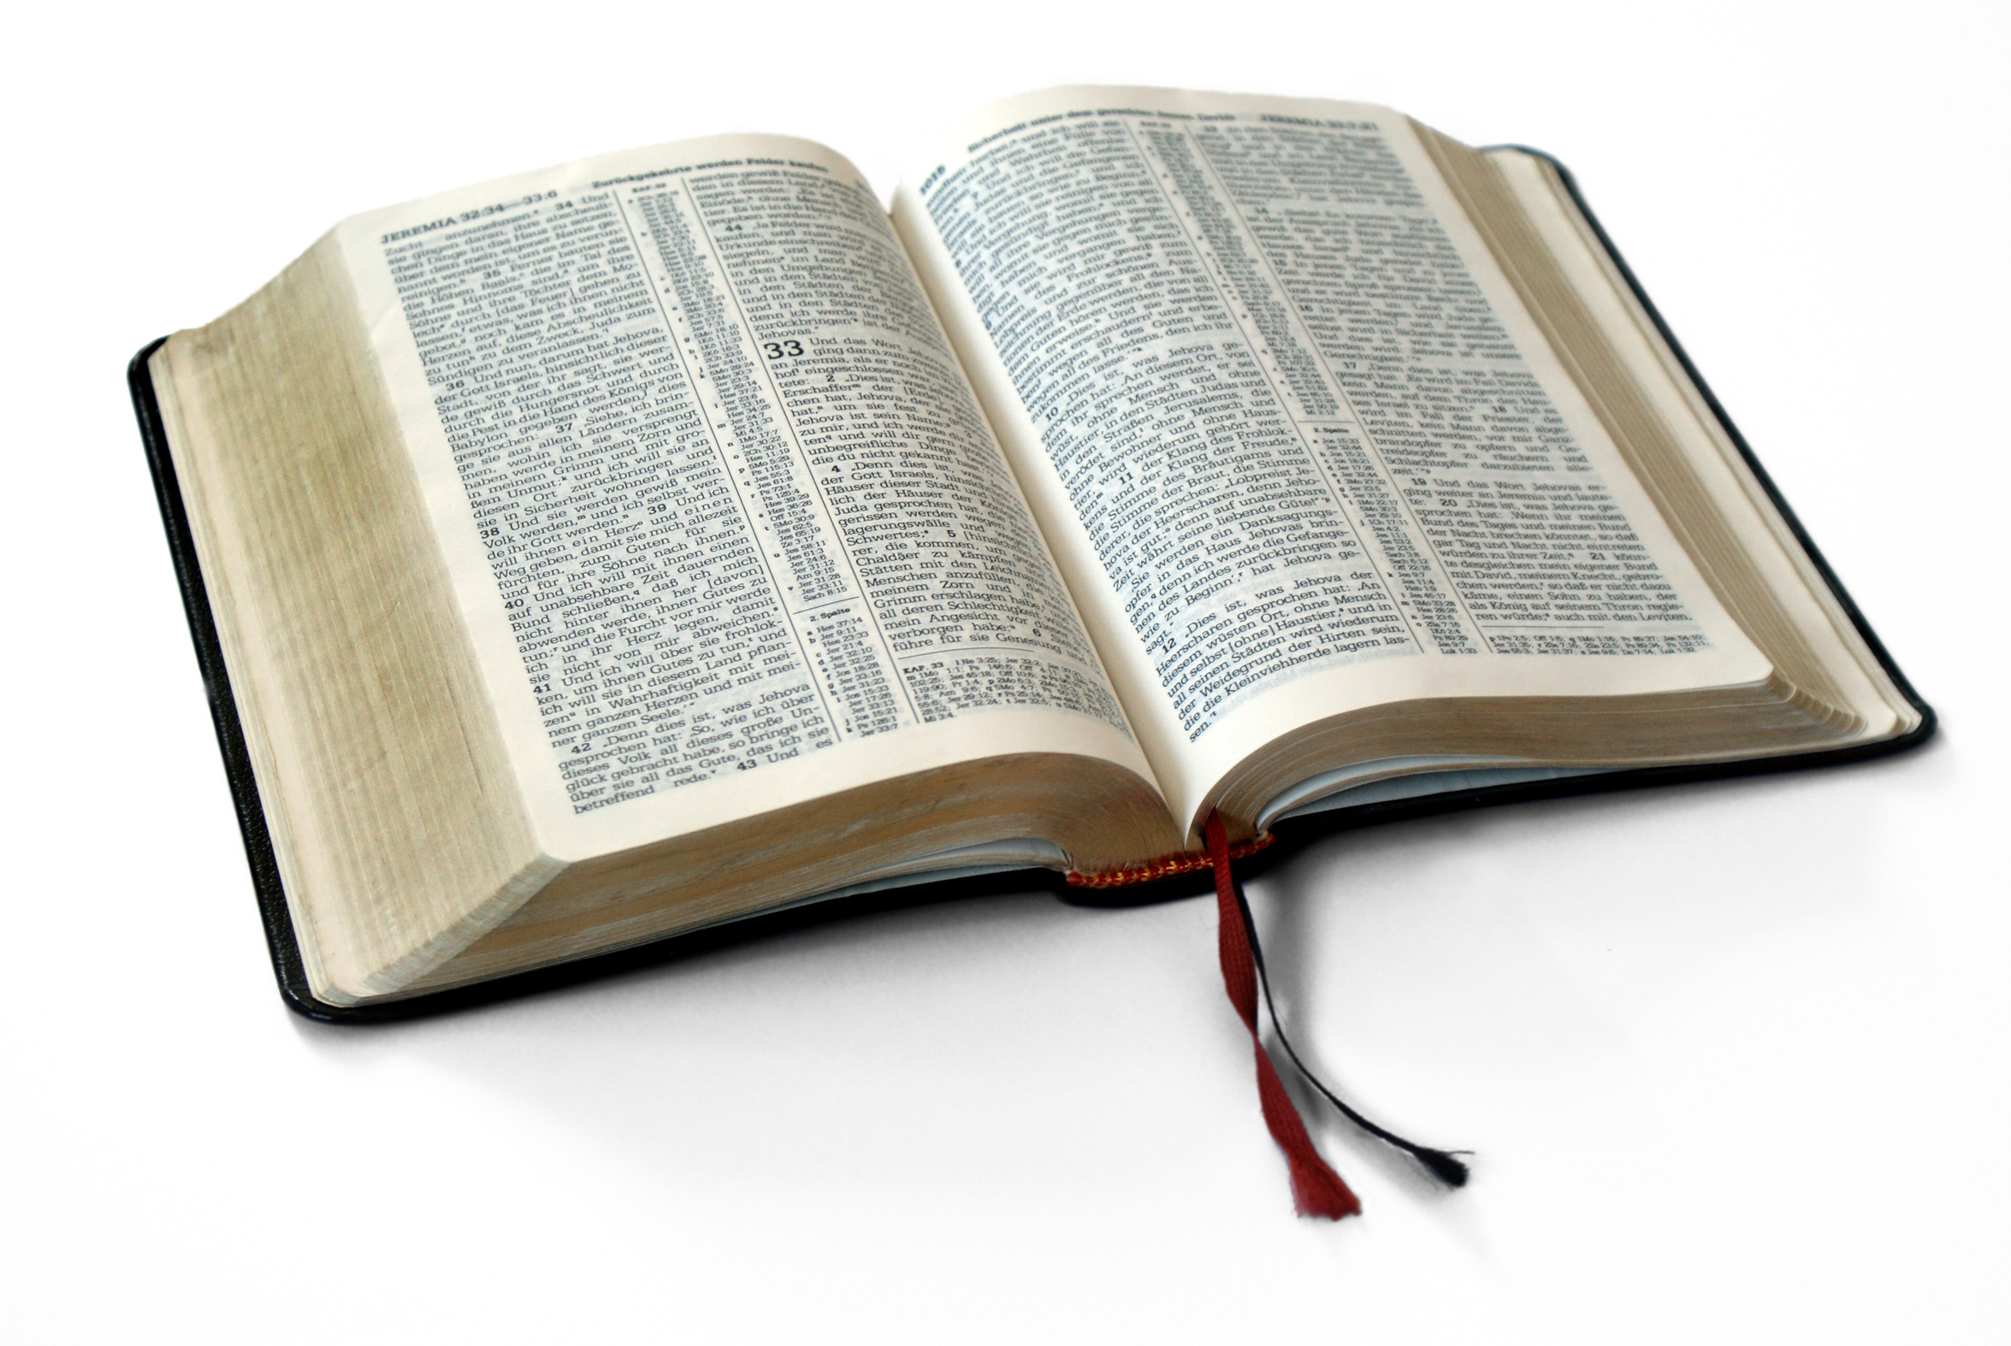
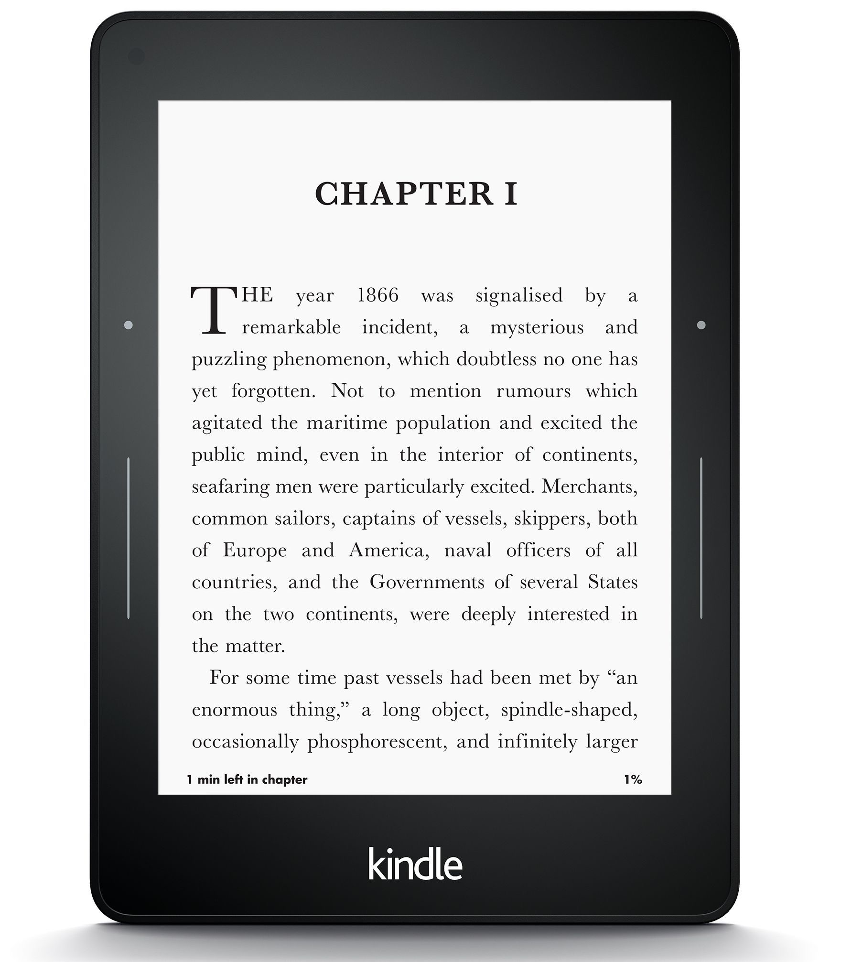
Diachronic word embeddings for studying language change!
Word vectors for 1920
Word vectors 1990
“dog” 1990 word vector
“dog” 1920 word vector
vs.
1900
1950
2000
￼
￼

Slide 106
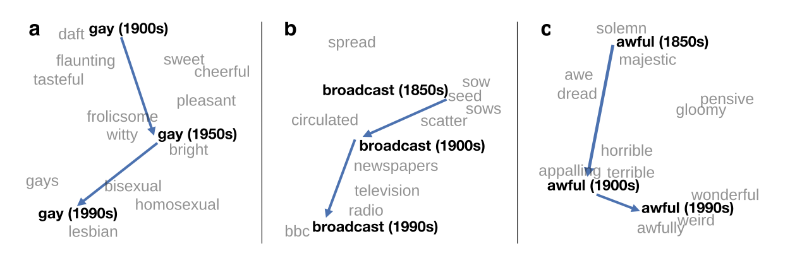
Embeddings as a window onto historical semantics
Train embeddings on different decades of historical text to see meanings shift
~30 million books, 1850-1990, Google Books data
William L. Hamilton, Jure Leskovec, and Dan Jurafsky. 2016. Diachronic Word Embeddings Reveal Statistical Laws of Semantic Change. Proceedings of ACL.
Notes:
Embeddings can also be a useful tool for studying how meaning changes over time, by computing multiple embedding spaces, each from texts written in a particular time period. For example these figures shows a visualization of changes in meaning in English words over the last two centuries, computed by building separate embedding spaces for each decade from historical corpora like Google N-grams and the Corpus of Historical American English.

Slide 107
Embeddings reflect cultural bias!
Bolukbasi, Tolga, Kai-Wei Chang, James Y. Zou, Venkatesh Saligrama, and Adam T. Kalai. "Man is to computer programmer as woman is to homemaker? debiasing word embeddings." In NeurIPS, pp. 4349-4357. 2016.
Ask “Paris : France :: Tokyo : x”
x = Japan
Ask “father : doctor :: mother : x”
x = nurse
Ask “man : computer programmer :: woman : x”
x = homemaker
Algorithms that use embeddings as part of e.g., hiring searches for programmers, might lead to bias in hiring
Notes:
In addition to their ability to learn word meaning from text, embeddings, alas, also reproduce the implicit biases and stereotypes that were latent in the text. As the prior section just showed, embeddings can roughly model relational similar- ity: ‘queen’ as the closest word to ‘king’ - ‘man’ + ‘woman’ implies the analogy man:woman::king:queen. But these same embedding analogies also exhibit gender stereotypes. For example the embeddings suggest the analogy ‘father’ is to ‘doctor’ as ‘mother’ is to ‘nurse’, and the closest occupation to ‘man’ - ‘computer programmer’ + ‘woman’ in word2vec embeddings trained on news text is ‘homemaker'
This could result in what Crawford calls an allocational harm, when a system allo- cates resources (jobs or credit) unfairly to different groups. For example algorithms that use embeddings as part of a search for hiring potential programmers or doctors might thus incorrectly downweight documents with women’s names.

Slide 108
Embeddings reflect cultural bias
Bolukbasi, Tolga, Kai-Wei Chang, James Y. Zou, Venkatesh Saligrama, and Adam T. Kalai. "Man is to computer programmer as woman is to homemaker? debiasing word embeddings." In Advances in Neural Information Processing Systems, pp. 4349-4357. 2016.

Slide 109
Embeddings reflect cultural bias
Caliskan, Aylin, Joanna J. Bruson and Arvind Narayanan. 2017. Semantics derived automatically from language corpora contain human-like biases. Science 356:6334, 183-186.
Implicit Association test (Greenwald et al 1998): How associated are
concepts (flowers, insects) & attributes (pleasantness, unpleasantness)?
Studied by measuring timing latencies for categorization.
Psychological findings on US participants:
African-American names are associated with unpleasant words (more than European-American names)
Male names associated more with math, female names with arts
Old people's names with unpleasant words, young people with pleasant words.
Caliskan et al. replication with embeddings:
African-American names (Leroy, Shaniqua) had a higher GloVe cosine with unpleasant words (abuse, stink, ugly)
European American names (Brad, Greg, Courtney) had a higher cosine with pleasant words (love, peace, miracle)
Embeddings reflect and replicate all sorts of pernicious biases.

Slide 110
Embeddings as a window onto history
Garg, Nikhil, Schiebinger, Londa, Jurafsky, Dan, and Zou, James (2018). Word embeddings quantify 100 years of gender and ethnic stereotypes. Proceedings of the National Academy of Sciences, 115(16), E3635–E3644
Use the Hamilton historical embeddings
The cosine similarity of embeddings for decade X for occupations (like teacher) to male vs female names
Is correlated with the actual percentage of women teachers in decade X

Slide 111
Historical embedding as a tool to study cultural biases
Garg, N., Schiebinger, L., Jurafsky, D., and Zou, J. (2018). Word embeddings quantify 100 years of gender and ethnic stereotypes. Proceedings of the National Academy of Sciences 115(16), E3635–E3644.
Compute a gender or ethnic bias for each adjective: e.g., how much closer the adjective is to "woman" synonyms than "man" synonyms, or names of particular ethnicities
Embeddings for competence adjective (smart, wise, brilliant, resourceful, thoughtful, logical) are biased toward men, a bias slowly decreasing 1960-1990
Embeddings for dehumanizing adjectives (barbaric, monstrous, bizarre) were biased toward Asians in the 1930s, bias decreasing over the 20th century.
These match the results of old surveys done in the 1930s
Notes:
Historical embeddings are also being used to measure biases in the past. Garg et al. (2018) used embeddings from historical texts to measure the association be- tween embeddings for adjectives and embeddings for names of various ethnici- ties or genders. embeddings for adjectives related to competence (‘smart’, ‘wise’, ‘thoughtful’, ‘resourceful’) had a higher cosine with male than fe- male words, and showed that this bias has been slowly decreasing since 1960, and that Historical embeddings also repli- cated old surveys of ethnic stereotypes; Embeddings for Chinese names were biased twoare dehumanizing adjectives like ‘barbaric’ in the 1930s, matching the results of old surveys done in the 1930s, but this bias decreased in both text and surveys over the 20th century.

Slide 112
Embeddings reflect ethnic stereotypes over time
Garg, Nikhil, Schiebinger, Londa, Jurafsky, Dan, and Zou, James (2018). Word embeddings quantify 100 years of gender and ethnic stereotypes. Proceedings of the National Academy of Sciences, 115(16), E3635–E3644
Princeton trilogy experiments
Attitudes toward ethnic groups (1933, 1951, 1969) scores for adjectives
industrious, superstitious, nationalistic, etc
Cosine of Chinese name embeddings with those adjective embeddings correlates with human ratings.

Slide 113
Change in linguistic framing 1910-1990
Garg, Nikhil, Schiebinger, Londa, Jurafsky, Dan, and Zou, James (2018). Word embeddings quantify 100 years of gender and ethnic stereotypes. Proceedings of the National Academy of Sciences, 115(16), E3635–E3644
Change in association of Chinese names with adjectives framed as "othering" (barbaric, monstrous, bizarre)

Slide 114
Changes in framing: adjectives associated with Chinese
Garg, Nikhil, Schiebinger, Londa, Jurafsky, Dan, and Zou, James (2018). Word embeddings quantify 100 years of gender and ethnic stereotypes. Proceedings of the National Academy of Sciences, 115(16), E3635–E3644

Slide 115
Vector Semantics & Embeddings
Properties of Embeddings
Notes:
We've seen various properties of embeddings, include how they reflect cultural biases in the text they are trained on.

Slide 116
Conclusion
Concepts or word senses
Have a complex many-to-many association with words (homonymy, multiple senses)
Have relations with each other
Synonymy, Antonymy, Superordinate
But are hard to define formally (necessary & sufficient conditions)
Embeddings = vector models of meaning
More fine-grained than just a string or index
Especially good at modeling similarity/analogy
Just download them and use cosines!!
Can use sparse models (tf-idf) or dense models (word2vec, GLoVE)
Useful in practice but know they encode cultural stereotypes

